Slide 1
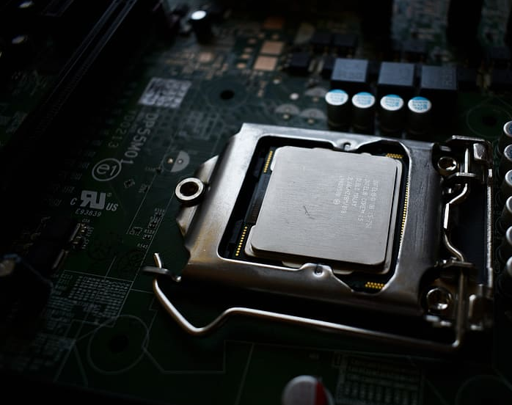

EECS 388: Embedded Systems Lecture 2: Embedded Software Development
Instructor: Tamzidul Hoque, Assistant Professor, Dept. of EECS, University of Kansas (hoque@ku.edu), office: Eaton 2038

Slide 2
Announcements
Labs and office hours start from next week
Lab section instructors:
Time |  | GTA NAME
Tu 09:00 - 10:50 AM EATN 3002 - LAWRENCE |  | Soma
Th 09:00 - 10:50 AM EATN 3002 - LAWRENCE |  | Ishraq
M 10:00 - 11:50 AM EATN 3002 - LAWRENCE |  | Ishraq
F 01:00 - 02:50 PM EATN 3002 - LAWRENCE |  | Soma
M 03:00 - 04:50 PM EATN 3002 - LAWRENCE |  | Ahsan
W 03:00 - 04:50 PM EATN 3002 - LAWRENCE |  | Ahsan
Absence in lab without valid reason will result in 30% penalty. Please attend the lab.

Slide 3
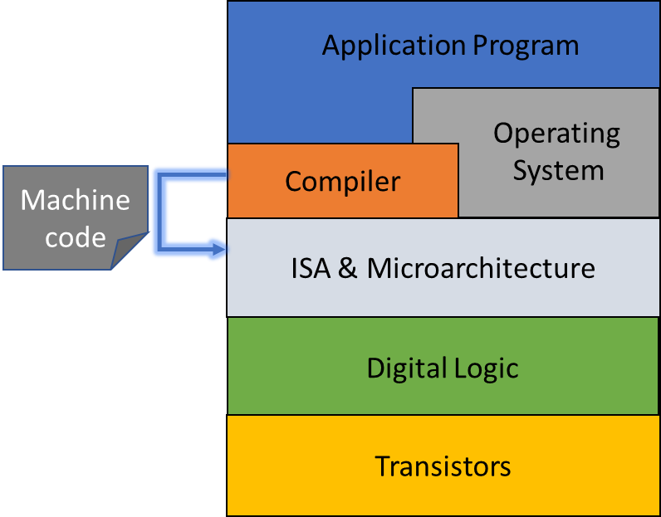
Context
We can look at embedded systems from different abstraction
Software Abstraction:
Application programs, operating system, compiler.
Hardware:
Primary component: microprocessor or microcontroller
Abstractions: microarchitecture and instruction set architecture, digital logic, transistor
Prepare on a host machine
Target embedded system
ISA: Instruction Set Architecture
Notes:
In an embedded system there is hardware and software. We look at it from various point of view or abstraction. From software abstraction, you will find three main components: Application programs, operating system, compiler.
From hardware abstraction, you have many ways to think about embedded system. The primary hardware component is a microprocessor or microcontroller. The highest abstraction for the processor is its architecture. Computer architecture concept is the combination of microarchitecture and instruction set architecture. Many different architectures exist, such as ARM, x86, MIPS, SPARC, and PowerPC.
To run a high level application program on a given architecture, the code has to be transformed to the machine language or executable binary. If two device have different ISA, their machine code will be different for the same high-level code.

Slide 4
Examples
Application Program
Blink_LED
Operating
System
Embedded Linux
Compiler
GCC
Machine code
ISA & Microarchitecture
ISA: ARM, x86, MIPS
Arch: Intel Pentium, AMD Athlon
Digital Logic
AND, XOR, NOT etc.
Transistors
NMOS, PMOS
ISA: Instruction Set Architecture
Notes:
In an embedded system there is hardware and software. We look at it from various point of view or abstraction. From software abstraction, you will find three main components: Application programs, operating system, compiler.
From hardware abstraction, you have many ways to think about embedded system. The primary hardware component is a microprocessor or microcontroller. The highest abstraction for the processor is its architecture. Computer architecture concept is the combination of microarchitecture and instruction set architecture. Many different architectures exist, such as ARM, x86, MIPS, SPARC, and PowerPC.
To run a high level application program on a given architecture, the code has to be transformed to the machine language or executable binary. If two device have different ISA, their machine code will be different for the same high-level code.

Slide 5
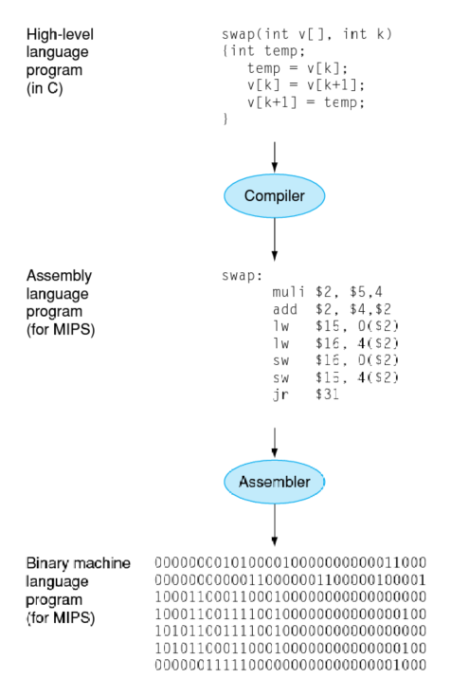
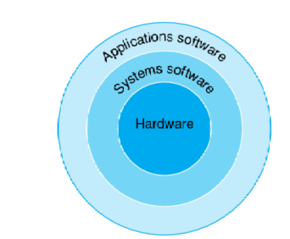
Example
Application software: Word processor, Internet browser
System Software: Operating system, compiler
OS: A supervising software that manages hardware resources to run the application software.
Compiler: Translates programs to machine executable binary
Hardware: Processor, memory, IO

Slide 6
Instruction Set Architecture (ISA)
ISA acts as an interface between the hardware and the software
Provides a model/abstraction of the hardware that can be controlled by writing programs in assembly language
ISA can be considered as a manual for the assembly programmer.
The ISA specifies the:
memory organization,
register set, and
instruction set (opcodes, data types, and addressing modes)
ARM, x86, MIPS, SPARC, and PowerPC
More reading: 1.7.4 The ISA: Introduction to Computing Systems, 3/e Yale N. Patt,
Notes:
The ISA specifies all the information about the computer that the software has to be aware of. In other words, the ISA specifies everything in the computer that is available to a programmer when he/she writes programs in the computer’s own machine language.
ISA is a structure of commands and operations used by software to communicate with hardware. The ISA specifies the memory organization, register set, and instruction set, including the opcodes, data types, and addressing modes of the instructions in the instruction set.
More reading: 1.7.4 The ISA: Introduction to Computing Systems, 3/e Yale N. Patt,

Slide 7

Analogy
ISA of a CPU lets the programmer knows the required information to control the hardware by writing a program
ISA of a car describes what the driver needs to know to make the car carry out the driver’s wishes
How to use the gas and break paddle
How to use the steering, indicators, and horn
Under the same ISA, different cars can be designed
Six vs eight cylinders→ ISA remains same
When we need different ISA for a car?
Manual vs automatic transmission
Notes:
Just like ISA of a computer lets the programmer knows the required information to control the hardware by writing a program, the ISA of a car describes what the driver needs to know to make the car carry out the driver’s wishes

Slide 8
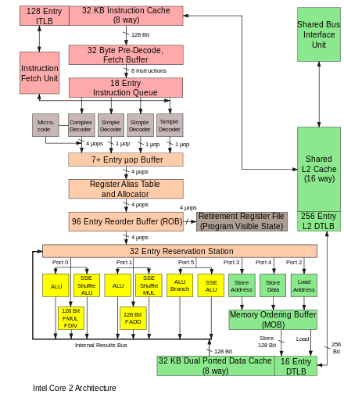
Microarchitecture
Diagrams that describe the interconnections of the microarchitectural elements
Implementation of the ISA
A given ISA may be implemented with different microarchitectures.
x86-64 ISA implemented by Intel and AMD have different microarchitecture
https://en.wikipedia.org/wiki/Microarchitecture
Notes:
The microarchitecture of a machine is usually represented as (more or less detailed) diagrams that describe the interconnections of the various microarchitectural elements of the machine, which may be anything from single gates and registers, to complete arithmetic logic units (ALUs) and even larger elements.
A microarchitecture is the hardware circuitry that implements one particular ISA.. A given ISA may be implemented with different microarchitectures.
For example, x86-64 is the ISA used by most modern laptop and desktop computers. It is implemented by various microarchitectures, including those designed by Intel and AMD. Software that is compiled for the x86-64 ISA can run on any microarchitecture designed to use the x86-64 instruction set.
While Intel Pentium and the AMD Athlon have very similar versions of the x86 instruction set, their internal microarchitectures is very different. A company can buy the license of an ISA and then implement the microarchitectures on their own. For example, Apple and Qualcomm uses ISA developed by ARM, but they implement the microarchitectures in different ways.

Slide 9

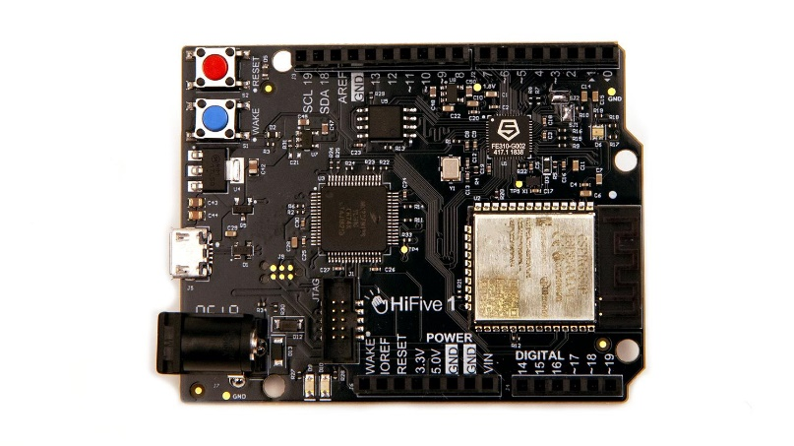
Embedded System Development Platform
When you want to program an embedded system, you first write the application program (in C) on a host machine.
The host machine has a compiler that generates the machine code.
This machine code will only run on this specific device or other devices with the same arch.
Host Machine
Blink_LED.C
Target (Embedded System)
Application
Processor
I/O
SW Tools
Programmer/Debugger
Memory
Compiler/IDE
Notes:
When you want to program an embedded system, you first write the application program (in C) on a host machine. The host machine has a compiler that generates the machine code. This machine code will only run on this specific device or other devices with the same architecture.
Using a hardware called programmer or debugger the machine code is transferred to the target device.

Slide 10
Due to the limited resource of the target, host machine usually contains our build environment
Host Machine
Code
Compiler toolchain
Executable
C
GCC (GNU Compiler Collection)
Binary file
Notes:
This is more details on what happens on the host machine. We usually prepare the binary on a host machine. The host machine has a compiler that takes the C code and coverts to binary. GCC is one specific compiler. There are others also.

Slide 11
Compiler Toolchain
Include header
Expand macro
Assembly code
*.c/*.h
*.i
*.s
Preprocessor
Compiler
gcc
.lib, .a
*.o
Exe
Assembler
Linker
as
ld
Machine code
Executable machine code
More reading: 11.4.3 The Compilation Process: Introduction to Computing Systems, 3/e Yale N. Patt,
Notes:
More Reading: https://medium.com/@meghamohan/everything-you-want-to-know-about-gcc-fa5805452f96#:~:text=GCC%20is%20an%20integrated%20distribution,Java%2C%20Fortran%2C%20and%20Ada.&text=The%20goal%20is%20to%20make,language%20that%20the%20system%20understands
Background notes:
A header file is a file with extension . h which contains C function declarations and macro definitions
All preprocessing directives begin with a # symbol in your program
The #include preprocessor is used to include header files to C programs. For example,
#include <stdio.h>Here, stdio.h is a header file. The #include preprocessor directive replaces the above line with the contents of stdio.h header file.
A macro is a fragment of code that is given a name. You can define a macro in C using the #define preprocessor directive.
Here's an example.
#define c 299792458 // speed of light
Slide content:
Inside the compiler (for instance GCC), the C code and all the header files first goes to a preprocessor.
Preprocessing
This steps does the following : Removal of Comments, Expansion of Macros, Expansion of the included files.
The lines in our code that begin with the “#” character are preprocessor directives. In our “HelloWorld.c” program the first preprocessor directive (#include <stdio.h>) requests a standard header file, stdio.h, to be included into our source file. If you use macros in your program , this is the stage where it gets substituted by the corresponding value.
This step generates an *.i file.
Compilation
The next step is to take the Preprocessed *.i file as input, compile it and produce Assembly code which is machine dependent.
Assembly
As we all know ,machines can understand only binary language, so now we require an ASSEMBLER that converts assembly code into binary code.
If there are any calls to external functions in the assembly code, the Assembler leaves the addresses of the external functions undefined, to be filled in later by the Linker.
a.out The oldest and `classic' unix object format. An object file and an executable file come in several new formats such as ELF (Executable and Linking Format) and COFF (Common Object-File Format). For example, ELF is used on Linux systems, while COFF is used on Windows systems.
If you compile your code without specifying the name of the output file, the output file produced has name ‘a.out’ but the format now have changed to ELF. It is just that the default executable file name remains the same.
Linking
This is the final phase in which all the linking of function calls with their definitions are done. Linker knows where all these functions are implemented (Assembler has left the address of all the external functions to be called). Till this stage GCC doesn't know about the function like printf() .The Assembler would have left the address of the functions to be called and Linker does the final process of filling in these addresses with the actual definitions. The linker also does a few additional tasks for us. It combines our program with some standard routines that are needed to make our program run. So the final executable size is way more than the input file!

Slide 12
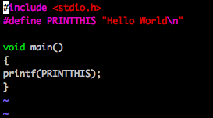
Preprocessing
Preprocessors enables the inclusion of header files, macro expansions etc.
Sometimes it is a separate program invoked by the compiler as the first part of translation.
What happens in preprocessing: Removal of Comments, Expansion of Macros, Expansion of the included header files
Header file
Macros
All preprocessing directives begin with a # symbol in your program
The first directives (#include <stdio.h>) requests a header file (stdio.h), to be included into the source code
Macro →fragments of codes that is given a name
Source: Link
Notes:
Background notes:
A header file is a file with extension . h which contains C function declarations and macro definitions
All preprocessing directives begin with a # symbol in your program
The #include preprocessor is used to include header files to C programs. For example,
#include <stdio.h>Here, stdio.h is a header file. The #include preprocessor directive replaces the above line with the contents of stdio.h header file.
A macro is a fragment of code that is given a name. You can define a macro in C using the #define preprocessor directive.
Here's an example.
#define c 299792458 // speed of light
Slide content:
Inside the compiler (for instance GCC), the C code and all the header files first goes to a preprocessor.
Preprocessing
This steps does the following : Removal of Comments, Expansion of Macros, Expansion of the included files.
The lines in our code that begin with the “#” character are preprocessor directives. In our “HelloWorld.c” program the first preprocessor directive (#include <stdio.h>) requests a standard header file, stdio.h, to be included into our source file. If you use macros in your program , this is the stage where it gets substituted by the corresponding value.
This step generates an *.i file.

Slide 13
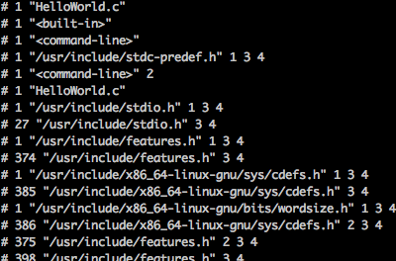
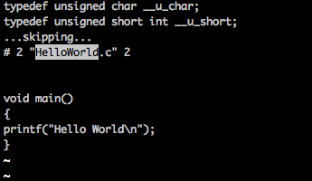
Example of Preprocessing Step
The header file and macro definition are expanded after preprocessing
Pre-processor
Expanded <stdio.h>
Input C code
Pre-processing is done by GCC’s “-E” flag
Source: Link
Expanded macro
Notes:
stdio. h is the header file for standard input and output. This is useful for getting the input from the user(Keyboard) and output result text to the monitor(screen)
In preprocessor stage those included header files and defined macros are expanded and merged within the source file to produce a transitory source file.
By using gcc’s “-E” flag we can directly do the pre-processing operation.

Slide 14
Compiler Toolchain
Include header
Expand macro
Assembly code
*.c/*.h
*.i
*.s
Preprocessor
Compiler
gcc
.lib, .a
*.o
Exe
Assembler
Linker
as
ld
Machine code
Executable machine code
More reading: 11.4.3 The Compilation Process: Introduction to Computing Systems, 3/e Yale N. Patt,

Slide 15
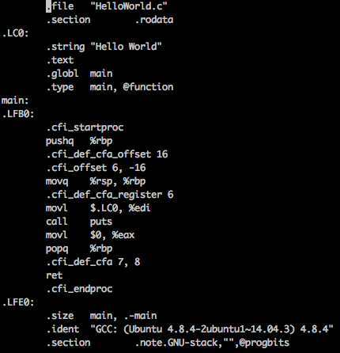

Compilation
Takes the Preprocessed file as input, compiles it and produces an intermediate compiled output.
The output file for this stage produces machine dependent Assembly code.
Invoked by –S flag
Source: Link
Notes:
Source: https://medium.com/@meghamohan/everything-you-want-to-know-about-gcc-fa5805452f96#:~:text=GCC%20is%20an%20integrated%20distribution,Java%2C%20Fortran%2C%20and%20Ada.&text=The%20goal%20is%20to%20make,language%20that%20the%20system%20understands.
By using “-S” flag with gcc we can convert the preprocessed C source code into assembly language

Slide 16
Compiler Toolchain
Include header
Expand macro
Assembly code
*.c/*.h
*.i
*.s
Preprocessor
Compiler
gcc
.lib, .a
*.o
Exe
Assembler
Linker
as
ld
Machine code/object code
Executable machine code
More reading: 11.4.3 The Compilation Process: Introduction to Computing Systems, 3/e Yale N. Patt,

Slide 17
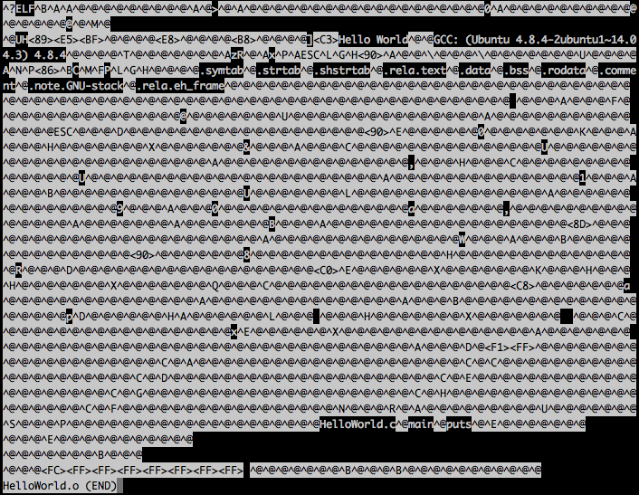
Assembly
Converts assembly code into object code (binary file unreadable by texteditor).
Object code is a portion of machine code that hasn’t yet been linked into a complete program.
Assembler leaves the addresses of the external functions (if any) undefined, to be filled in later by the Linker.
After the linking is done, we get an executable file that can be executed on the CPU
ELF: executable and linkable format.
Source: Link
Notes:
Source: Link
Assembly
As we all know ,machines can understand only binary language, so now we require an ASSEMBLER that converts assembly code into object code.
If there are any calls to external functions in the assembly code, the Assembler leaves the addresses of the external functions undefined, to be filled in later by the Linker.
a.out The oldest and `classic' unix object format. An object file and an executable file come in several new formats such as ELF (Executable and Linking Format) and COFF (Common Object-File Format). For example, ELF is used on Linux systems, while COFF is used on Windows systems.
If you compile your code without specifying the name of the output file, the output file produced has name ‘a.out’ but the format now have changed to ELF. It is just that the default executable file name remains the same.
Object code is a portion of machine code/executable not yet linked into a complete program. It's the machine code for one particular library or module that will make up the completed product. It may also contain placeholders or offsets not found in the machine code of a completed program. The linker will use these placeholders and offsets to connect everything together.
Executable is binary (1's and 0's) code that can be executed directly by the CPU. If you were to open a machine code file in a text editor you would see garbage, including unprintable characters (no, not those unprintable characters ;) ).
Linking
This is the final phase in which all the linking of function calls with their definitions are done. Linker knows where all these functions are implemented (Assembler has left the address of all the external functions to be called). Till this stage GCC doesn't know about the function like printf() .The Assembler would have left the address of the functions to be called and Linker does the final process of filling in these addresses with the actual definitions. The linker also does a few additional tasks for us. It combines our program with some standard routines that are needed to make our program run. So the final executable size is way more than the input file!
Machine code is a direct representation of CPU instructions for some CPU architecture.
An executable file can contain machine code in a format suitable for the operating system to load it into memory and transfer direct CPU instruction to.

Slide 18
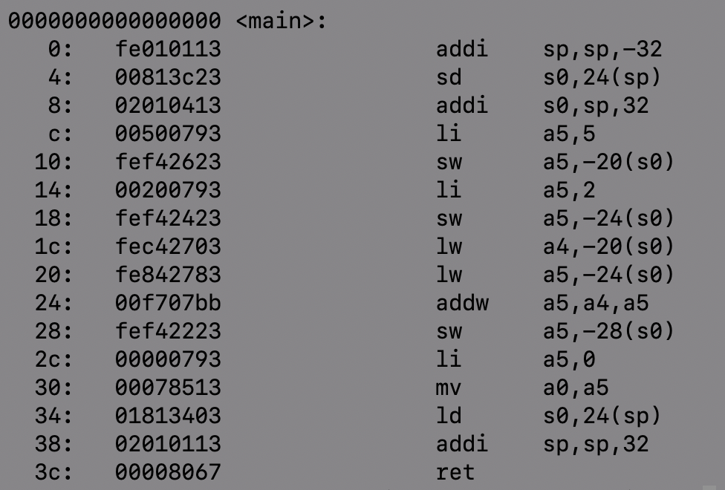
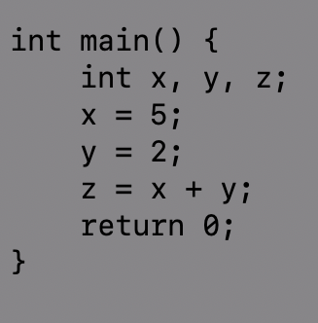
gcc -S
gcc -c
C-code
Assembly
Binary
Notes:
This is an example C program. It shows the sum of two variable.
This is compiled for RISC 5 ISA.
The assembly code is shown in the middle
The assembly code is further coverted to executable binary and it looks like the hex file
Machine code or binary is a direct representation of CPU instructions for some CPU architecture.
An executable file can contain machine code in a format suitable for the operating system to load it into memory and transfer direct CPU instruction to.

Slide 19
Native Compilation
Compile and run on one system
Host Machine (Linux/Windows)
*.c *.h
Compiler Toolchain
Exe
No extra hardware needed for sending/programming the .exe
Notes:
When I compile a code to run on the host machine, it is called native compilation. Say you wrote a script to automate some tasks
On your computer. You will do native compilation to generate the executable.

Slide 20
Cross Compilation
Compile on one system and run on another system
Host Machine (Linux/Windows)
Embedded System
*.c *.h
Compiler Toolchain
Exe
µ-processor
Flash
Programmer hardware
Notes:
But when you are planning to a run a code on a different machine or hardware (e.g. embedded processor) that has a different ISA from your host computer, you have to cross compilation.

Slide 21
Building can be too complex
Many gcc flags and commands
Linux has over 40k+ source code files!
Dependencies
Many source files
Many supported platforms
Building manually is
Not scalable
Time consuming
Error prone
Notes:
If you have a lot of source files, it is hard to compile the C program by typing manually on the command line.
The project may have several source files, and sometime we only alter a few source files before re-generating an executable.
If we recompile everything, each time we generate an executable, it will take a lot of time. Ideally, we only want to recompile the
Source codes that have been altered.
More reading: https://www.srcmake.com/home/make

Slide 22
GNU Make
“GNU Make is a tool which controls the generation of executables and other non-source files of a program from the program's source files”
Preprocessing
Compiling
Assembling
Linking
Notes:
That is why we can use GNU Make where we can write a make file to systematically compile large projects

Slide 23
GNU Toolchain
Makefile
Makefile
*.s
*.s
*.s
*.s
Assembler
*.lib
*.a
*.lib
*.a
Executable
Linker
*.c
*.h
*.s
*.c
*.h
*.o
Assembler
Makefile
Notes:
In a project we have assembly files. Libraies,
More reading: https://www.cs.colby.edu/maxwell/courses/tutorials/maketutor/

Slide 24
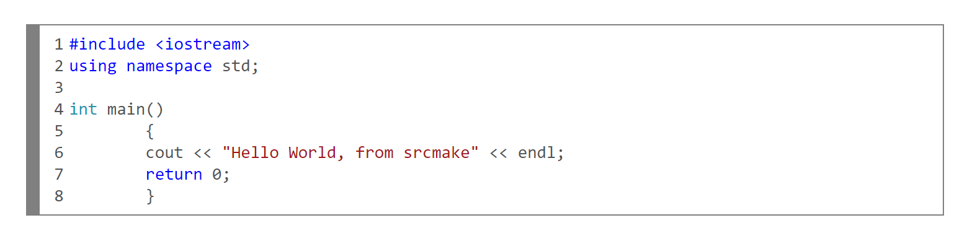
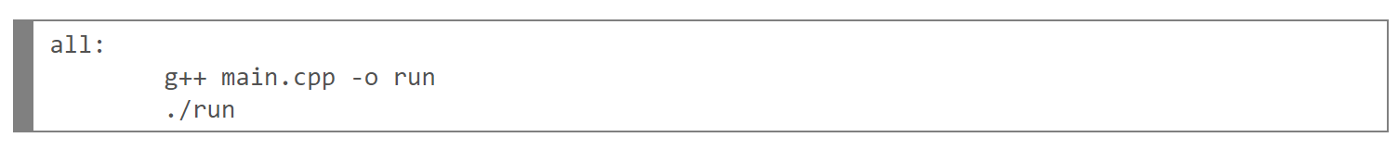
A Simple Makefile:
Simple Hello World code in a file named main.cpp.
To compile this, we'd use the following command in a terminal:
To use run, we'd then do the following:
​To create a make file, we just need to write the following into a file named "makefile":
To use our make file, all we need to do is type "make" into the terminal.
Source: link
Notes:
In the lab we are not likely to need makefile
Show this one instead: https://www.srcmake.com/home/make
Header file:
To find header files compiler checks default header file directory, for linux systems it is “/usr/include”. In above example our compiler is not going to find “myheader.h” because it’s not a standard c header file. To help compiler we use “myheader.h” instead of <myheader.h> which tells compiler that compiler should check for the header in same directory where the source file exists.
https://devansh42.medium.com/why-we-use-header-files-in-c-and-c-60642c392bcf

Slide 25
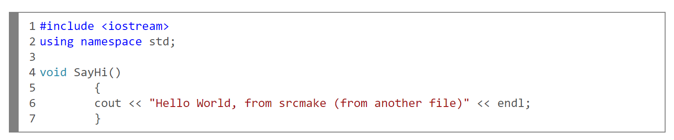
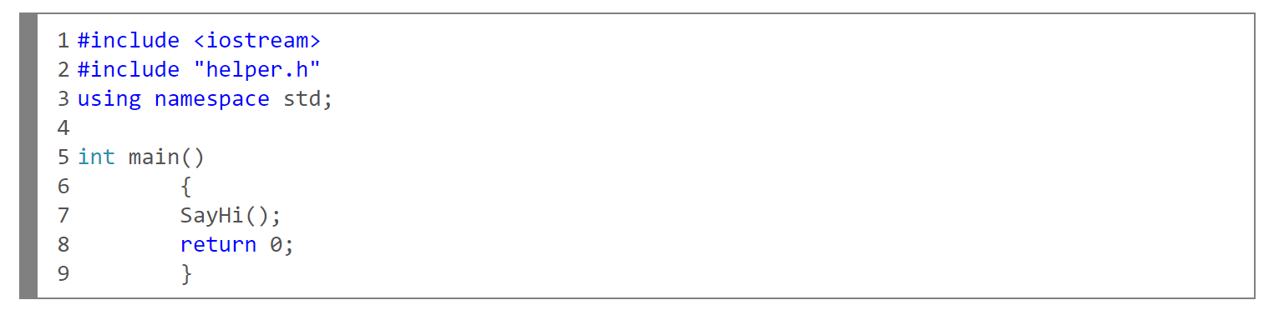
Example with Headers:
​Say, we copy the code to a new file called helper.cpp, instead of the main.cpp
we need a header file to match this .cpp file, so let's create a file called helper.h
our main.cpp file will now include this header, and make use of the SayHi() function
Now to compile this, we need the do the following:

Slide 26
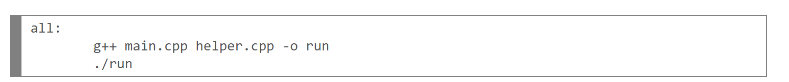
A Simple Makefile (Cont.):
Now to compile this, we need the do the following:
The make file that can be used here:
Command that will run the makefile

Slide 27
Integrated Development Environment (IDE)
Autogenerate Makefiles
Provide a very simple interface for developers (usually beginners)
Bad for maintainability and portability
Professional software teams write their own makefile
In the lab, for software development on the microcontroller, we will use Visual Studio Code (VSCode) and PlatformIO IDE combination
Notes:
Integrated development environments are designed to maximize programmer productivity. IDEs present a single program in which all development is done. This program typically provides many features for authoring, modifying, compiling, deploying and debugging software. In the lab we are using IDE.

Slide 28
Recap
Application Program
Compiler toolchain
Cross compilation
GNU Make
IDE
Prepare on a host machine
Operating
System
Compiler
Machine Language (ISA)
Digital Logic
Target embedded system
Electronic Circuits
Transistors

